Slide 1

CarePredictAI
Smart Patient Management System

Slide 2
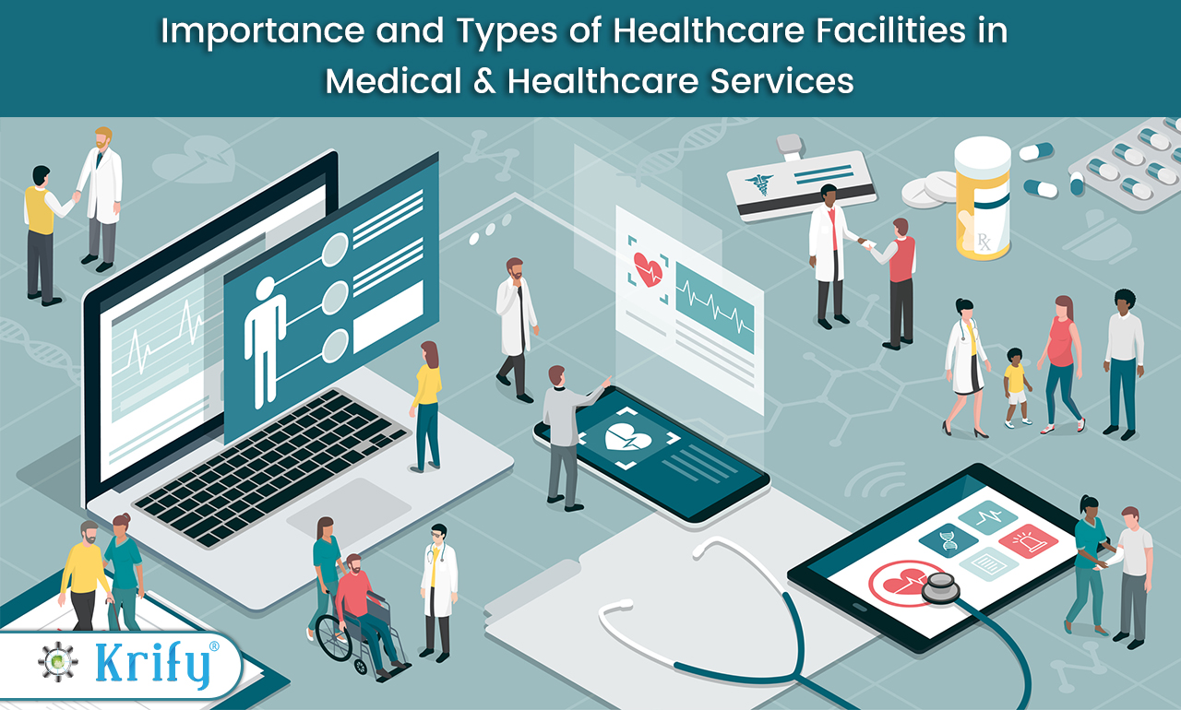
Business Background
• Built for South African healthcare facilities
• Sorts patients by risk using symptoms
• Chatbot check-in system
• Powered by Python ML models
• Scalable to hospitals & clinics nationwide

Slide 3

Problem Definition
• Long queues delay access to care
• Patients with low risk wait same as high risk
• Overwhelms staff, reduces satisfaction
• Lack of prediction tools for urgent cases

Slide 4

Benefits Of AI
Predicts high-risk patients automatically.
Prioritizes urgent cases, improves resource allocation.
Reduces waiting times and improves community health outcomes.
Enhances staff efficiency and patient satisfaction.

Slide 5
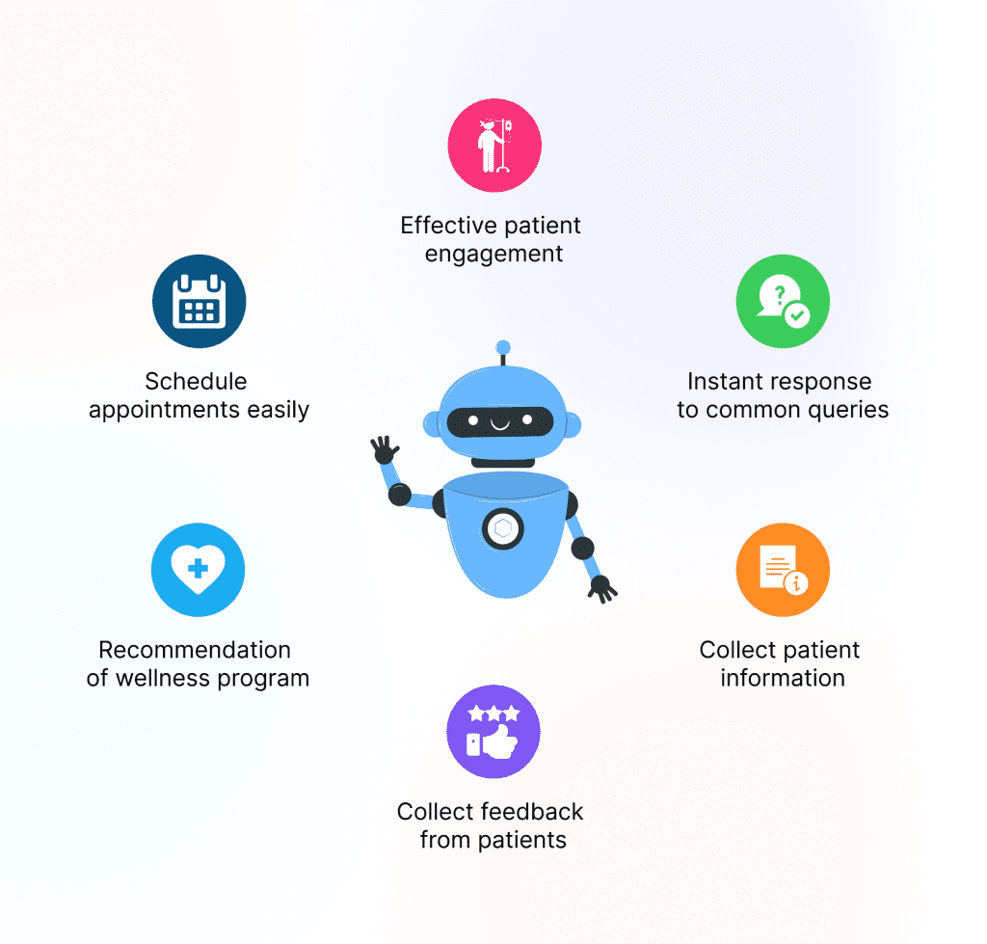
AI Solution
AI model estimates risk level instantly.
Uses machine learning and NLP for understanding symptoms.
Helps doctors prepare and reduces file creation time.
Chatbot collects patient info (name, age, symptoms, history, lifestyle).

Slide 6
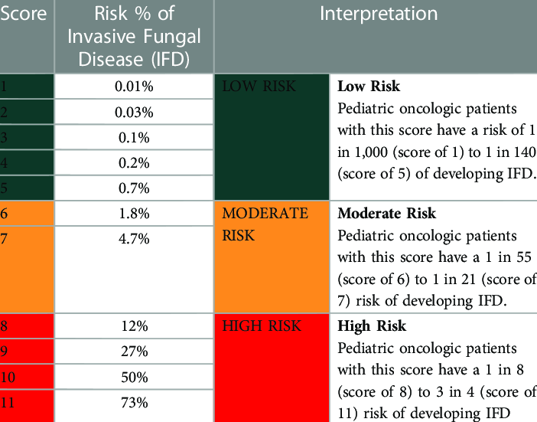

Business Objectives
• Predict patient risk levels at entry
• Classify patients: critical, moderate, low risk
• Reduce waiting times
• Chatbot for patient information entry
• Support doctors & admins in decision-making

Slide 7
Requirements
• Patient datasets: admissions, diagnoses, demographics
• Staff training for chatbot/AI usage
• Secure patient data storage
• Python ML models for predictions

Slide 8
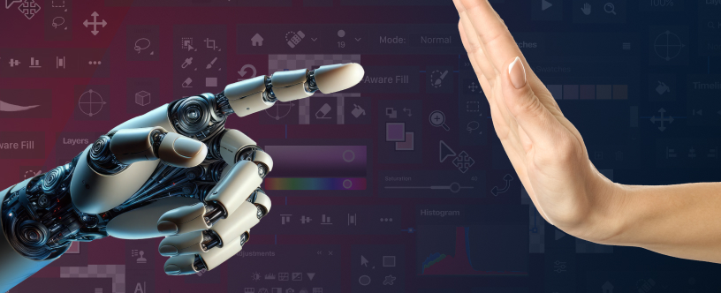
Constraints
• Missing or imbalanced data records
• Limited availability of quality datasets
• Staff resistance to new tech
• Infrastructure limits in rural areas
• Ethical & government approval concerns

Slide 9
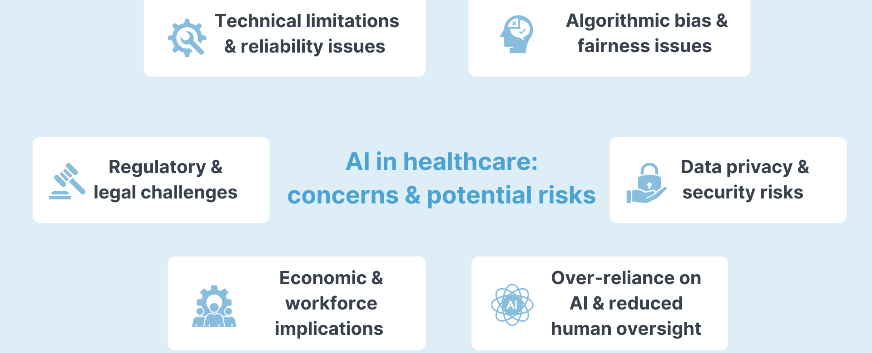
Risks
• Technical: overfitting, slow training
• Ethical: misuse without oversight
• Data privacy breaches
• High implementation costs

Slide 10
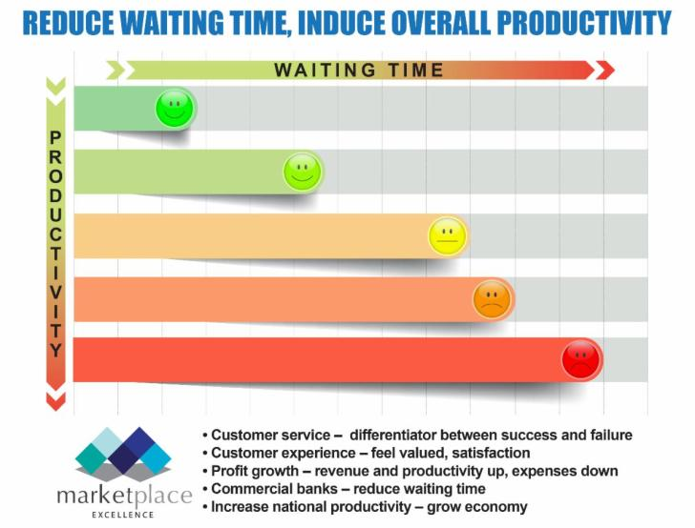
Business Success Criteria
Reduce waiting times by 40–60%.
80% accuracy in risk prediction.
30% reduction in admin costs.
70% user satisfaction rate.
Compliance with POPIA.
Scalable across hospitals

Slide 11

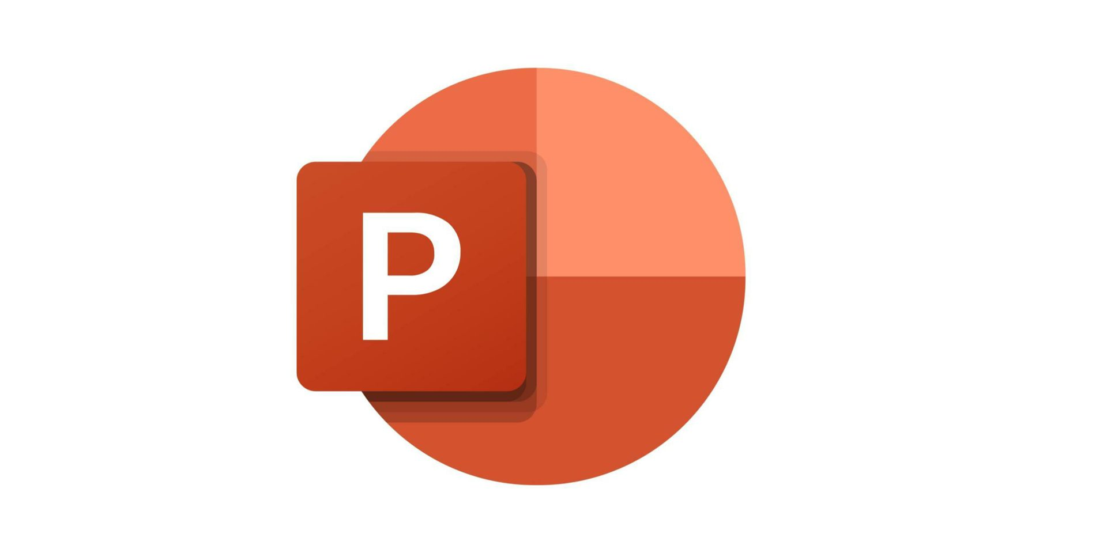
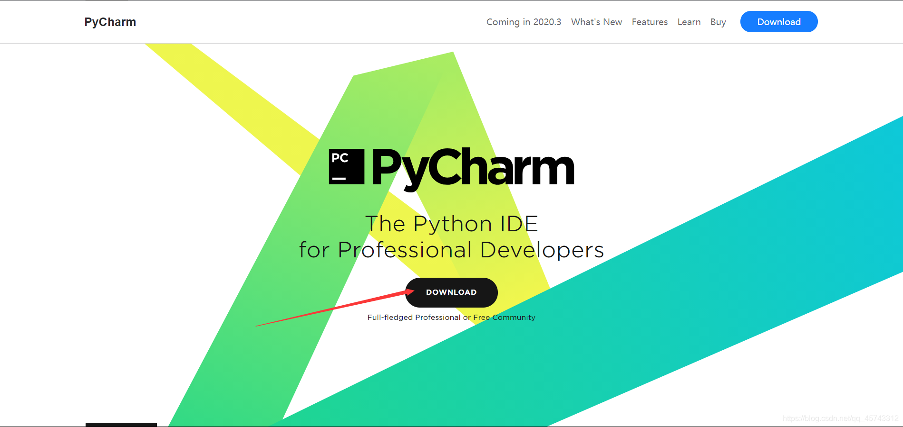
Tools & Techniques
Tools • PyCharm: AI model & chatbot development
• PowerPoint: solution presentations
• GitHub: collaboration & version control
• PyCharm, GitHub, Python 3.13, XGBoost, TF-IDF, Label Encoder, Pandas
Techniques
• Supervised learning
• SWOT analysis
• Data cleaning and analysis

Slide 12
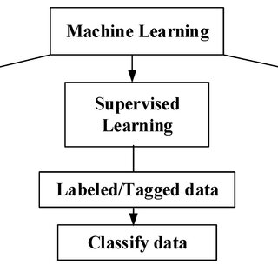
Machine Learning Approach
Uses XGBoost for classification (low, moderate, high risk).
Trained on clean, relevant patient data.
Continuously improves over time.

Slide 13

Data & Model
Data: Simulated medical datasets (age, gender, symptoms, lifestyle). Model Lifecycle:
Data collection
Preprocessing
Feature extraction
Model training
Evaluation Output: Patient risk score & queue priority.

Slide 14
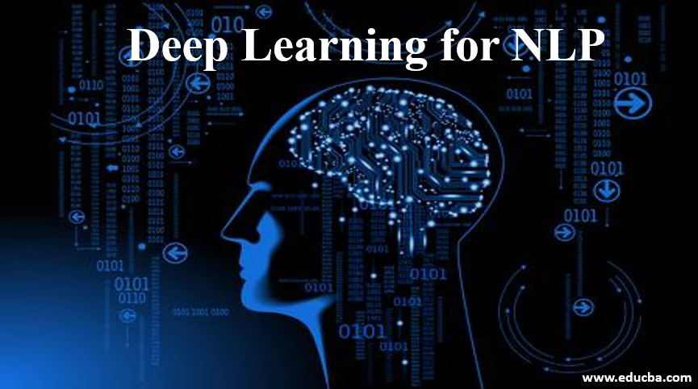
Solution Techniques
Machine Learning (XGBoost)
TF-IDF for NLP symptom processing
Label Encoding for categorical variables
Continuous model improvement
NLP and Deep Learning
NLP(TF-IDF) used to interpret patient text input.
Future upgrades:
Speech recognition and speech synthesis
Deep learning (TensorFlow/Keras) for improved accuracy

Slide 15

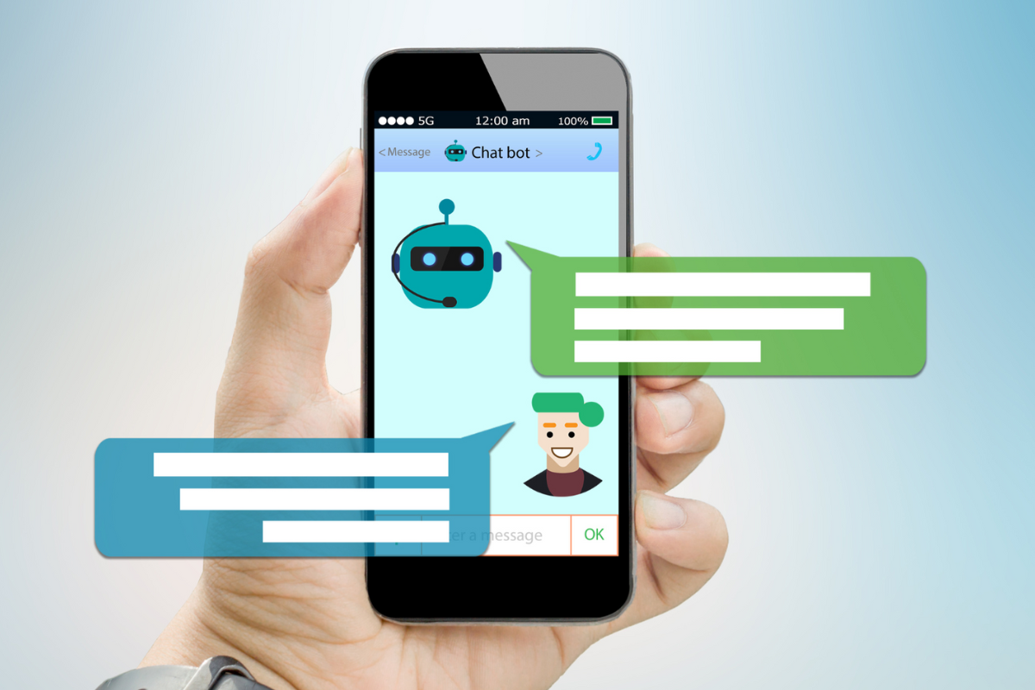
Tools & Techniques
Other Features
Real-time digital record management.
Friendly chatbot interface for patient interaction.
Handles unexpected input gracefully.
Future-ready and easily upgradable.

Slide 16

Conclusion
• AI improves hospital efficiency & saves lives
• Reduces waiting lines via chatbot check-in
• Prototype shows promise despite limitations
• Scalable impact for South Africa and beyond

